Slide 1
Landforms and Landscapes

Slide 2
Learning Intention:
Explore the different types of landforms and landscapes.
Success Criteria:
Identify and define different forms of landforms and landscapes.
List landforms in a country, state or local area.

Slide 3
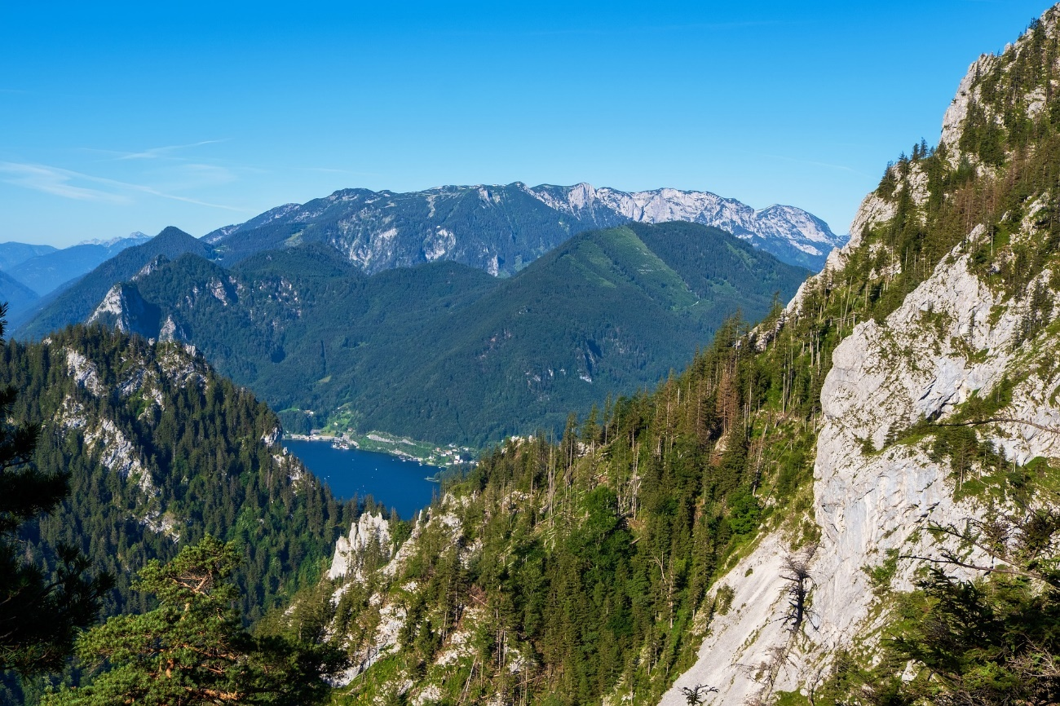
What is a Landform?
Have a think – what do you think a landform is?
Talk to a partner or with the class.

Slide 4
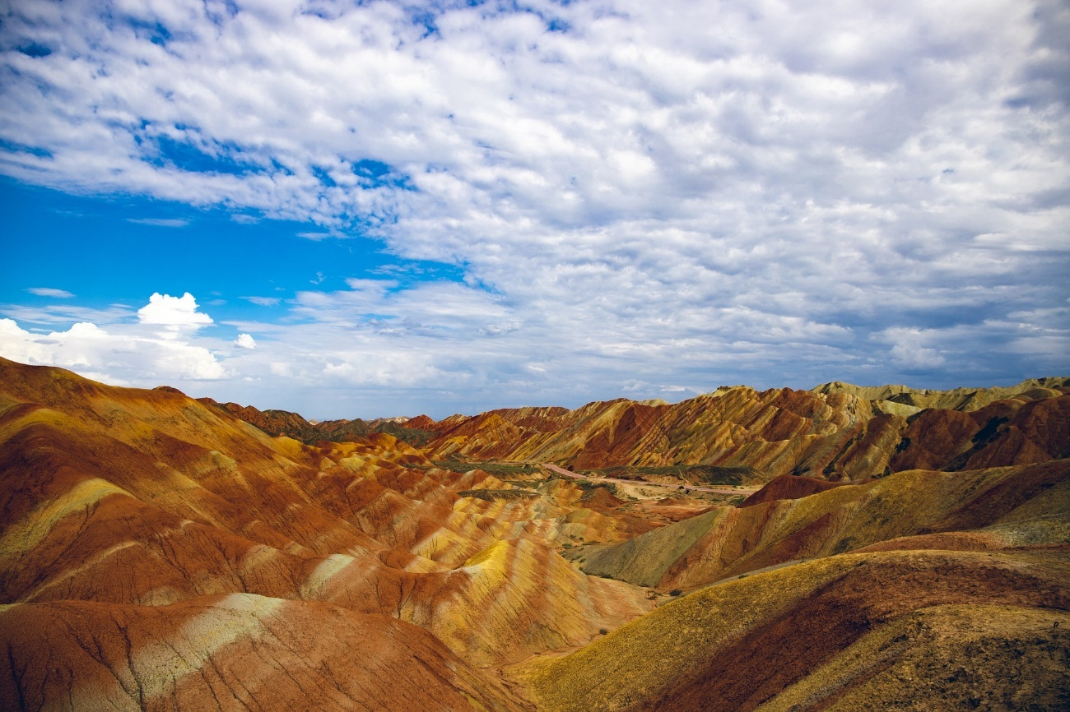
What is a Landform?
Landforms are naturally-formed features that can be found on Earth’s surface. Many of them are created by natural forces such as the sea or wind.
Landforms often occur above sea level, but some can form under the ocean.
There are many different types of landforms. How many can you think of?

Slide 5
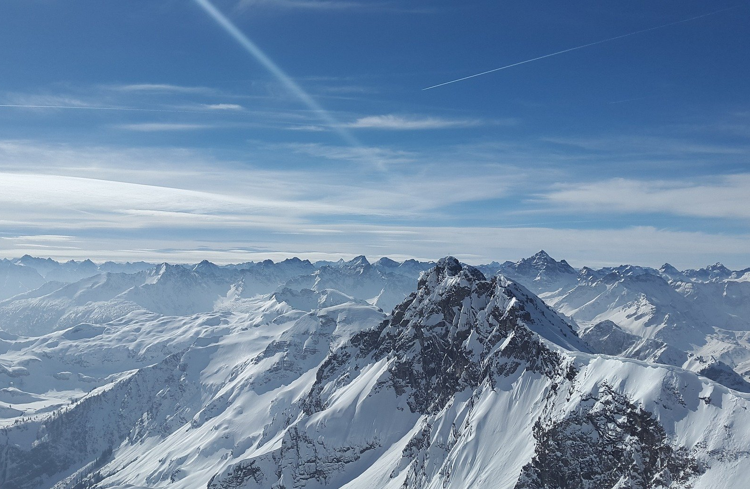
Mountains
Mountains are parts of the Earth’s surface which rise 300 metres into the air or higher. They often have very steep slopes and a rocky surface.
Anything smaller than 300 metres is known as a hill.
Formed by tectonic plates on the Earth's surface pushing against each other

Slide 6
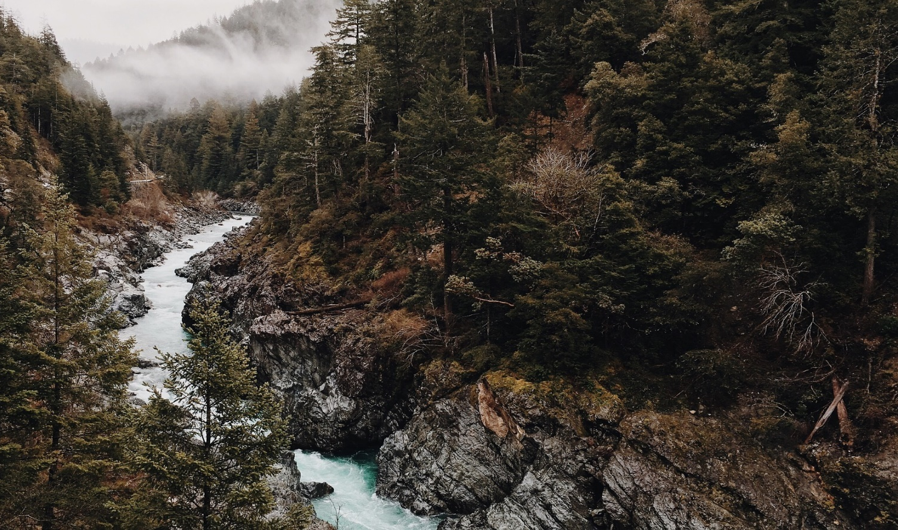
Valleys
Valleys are low areas that are found between mountains or hills. There is often a stream or a river running through a valley.

Slide 7
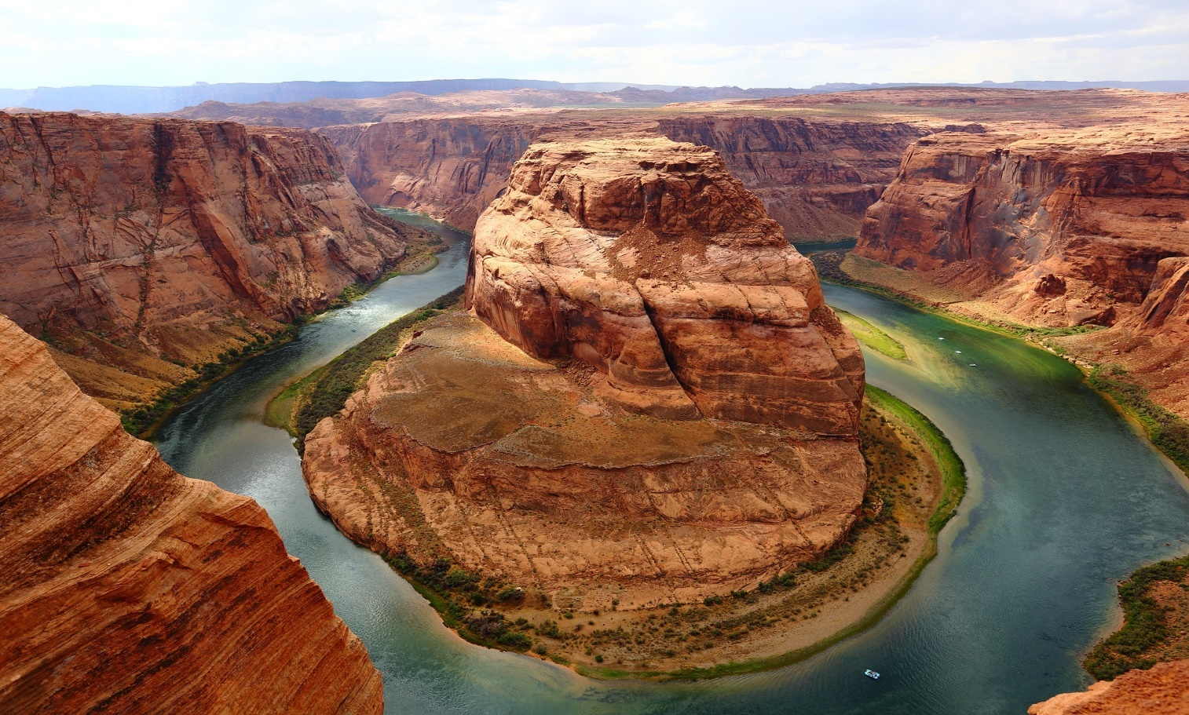
Canyons
Also known as a gorge, a canyon is similar to a valley, but it is often deeper and has narrower sides. Most canyons tend to form after many years of rivers cutting through layers of rock.

Slide 8
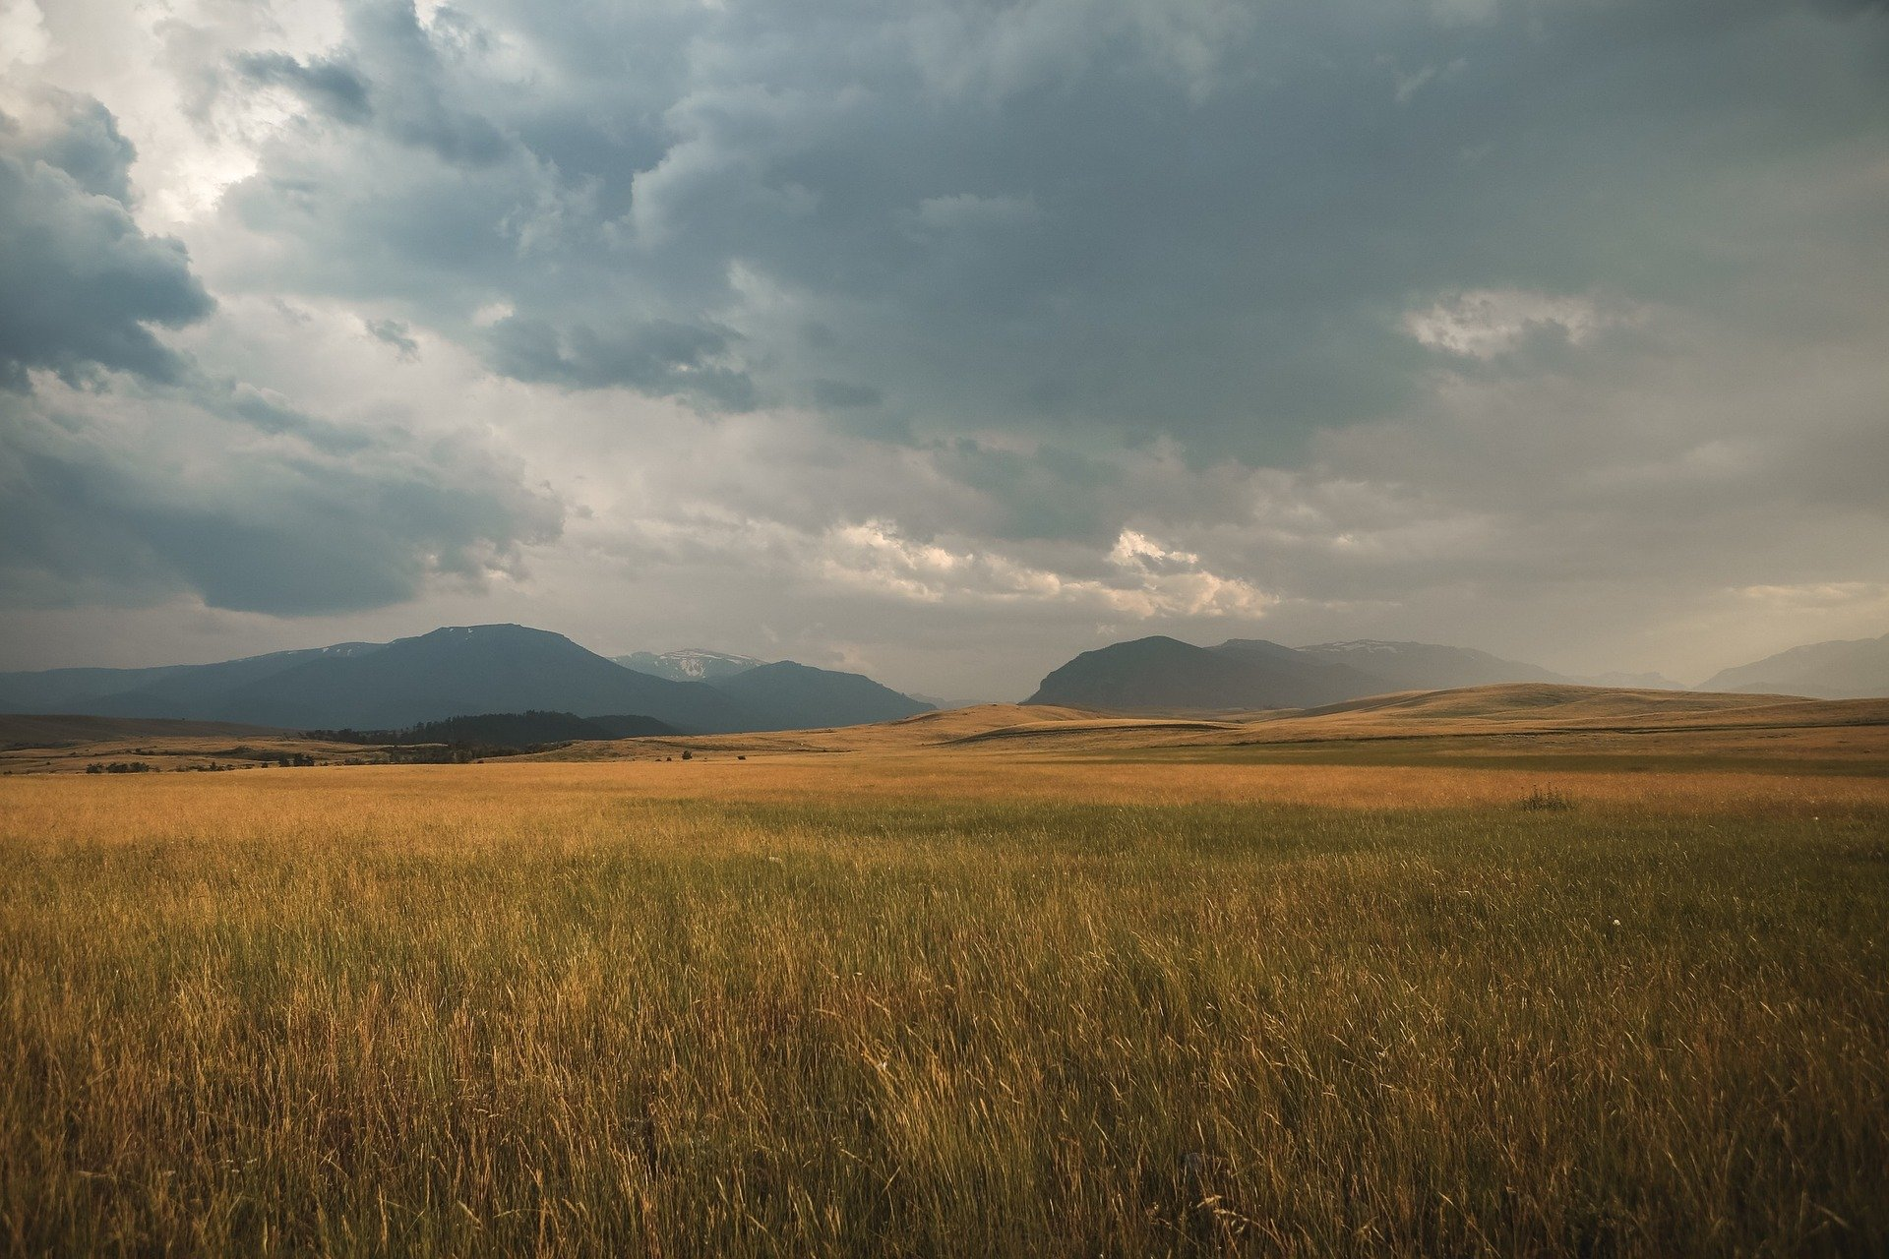
Plains
Plains are flat areas of land that have very little slopes, hills or any other types of landforms. They are often found in the centres of valleys or on plateaus.

Slide 9
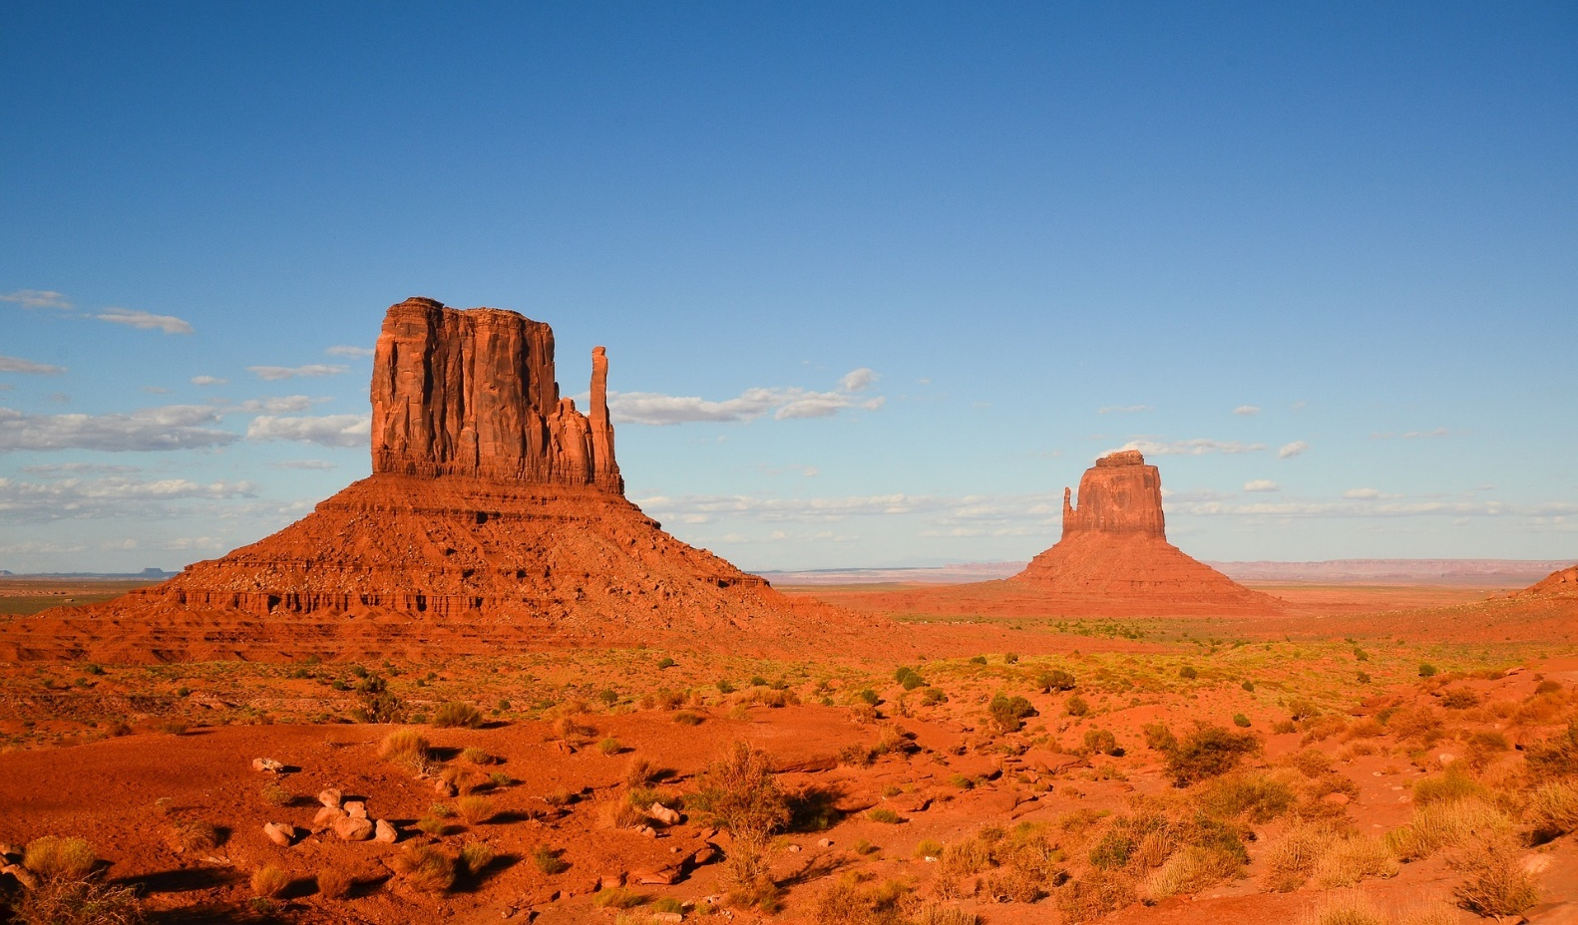
Plateaus
A plateau is a plain which is raised higher than the surrounding area. Plateaus have very steep cliffs around their edge.

Slide 10
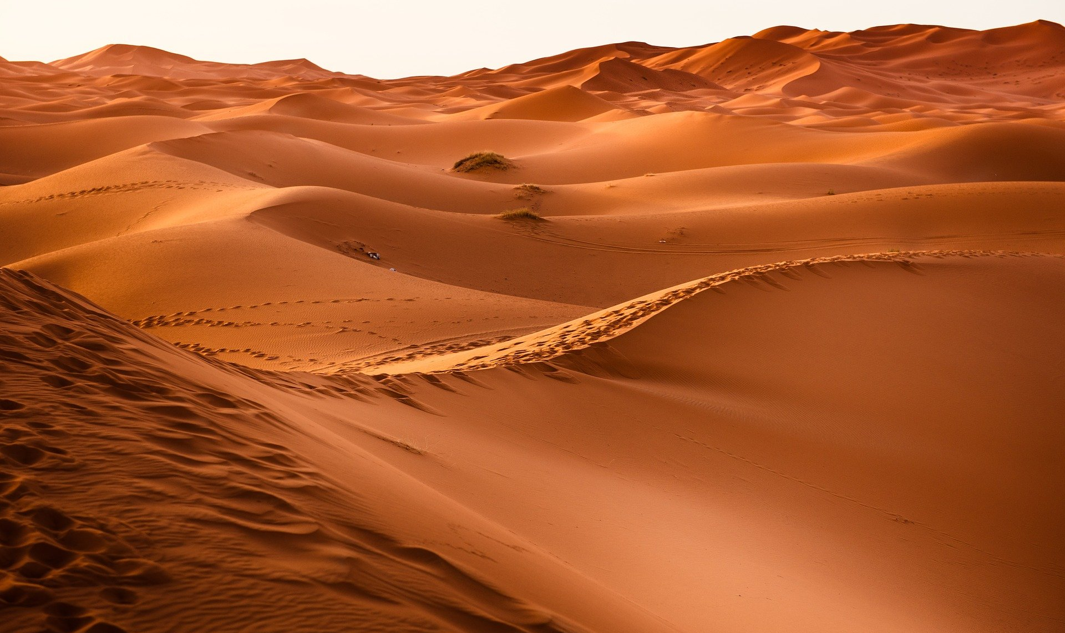
Deserts
Deserts are areas of land where there is little water. As a result, there are very few animals and plants around. With no plants to support the soil, wind erodes the land, creating sand dunes.

Slide 11
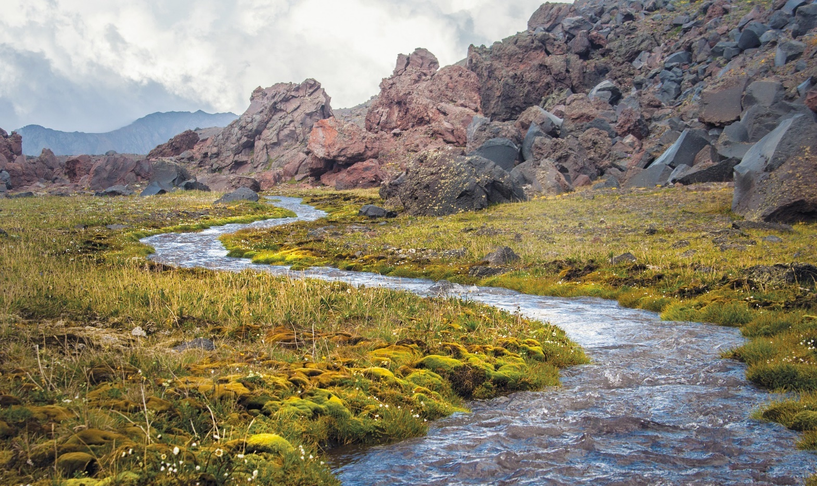
Rivers
Rivers are bodies of water that snake along the land. They are pulled downhill by gravity and flow into the ocean, a lake or other rivers. They come in a variety of sizes and can be shallow or deep.

Slide 12
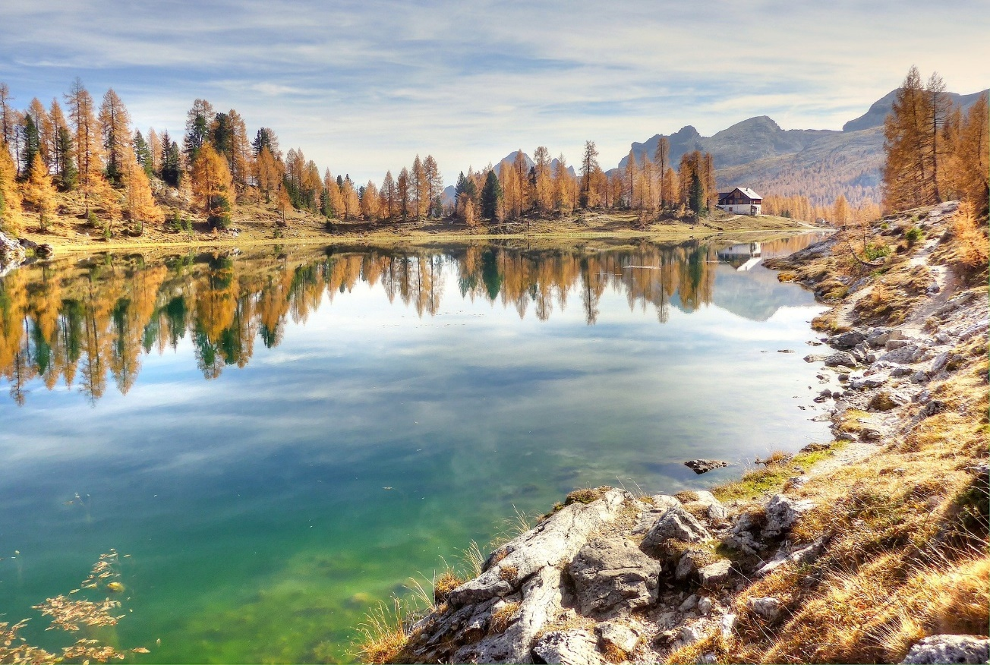
Lakes
A lake is a landlocked body of water. It can be made of slow moving water or still water. These lakes are fed water by rivers or rainfall.
A body of water that is smaller than a lake and shallow enough for the light to reach the bottom is known as a pond.

Slide 13
Islands
An island is an area of land surrounded by water. It is smaller than a continent.
A group of islands is known as an archipelago.

Slide 14
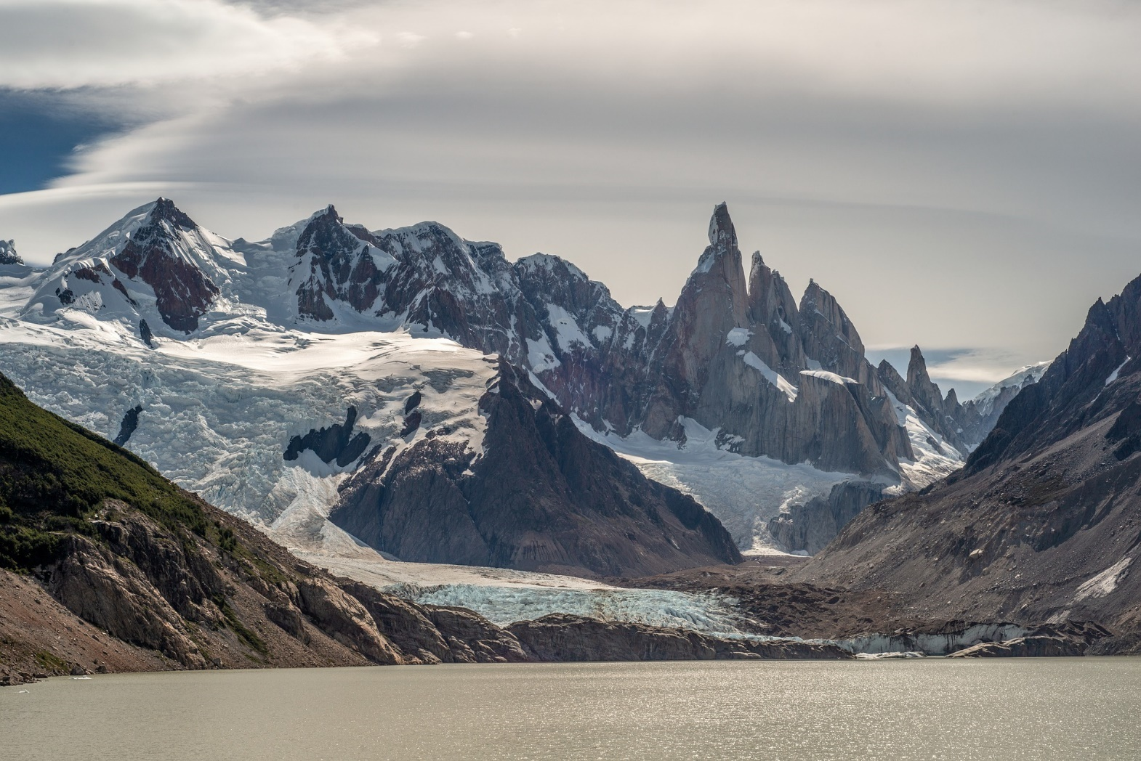
Glaciers
Glaciers are masses of slowly moving ice. They usually form on mountains after snow, rock, water and ice builds up. Pulled downwards by gravity, glaciers can flow down mountains like a river.

Slide 15
Finding Landforms Activity
Think about a place that you know well, it could be Australia, your state or your local area. What landforms can you find there?
Work with a partner or as a group to write down your answers.

Slide 16
What is a Landscape?
A landscape is the visible features of an area of land, its landforms, and how they integrate with natural or man-made features
There are 7 different types of landforms. How many can you think of?

Slide 17
Mountain Landscapes
A collection of mountains is known as a Mountain Range. This is also known as a mountain landscape.

Slide 18
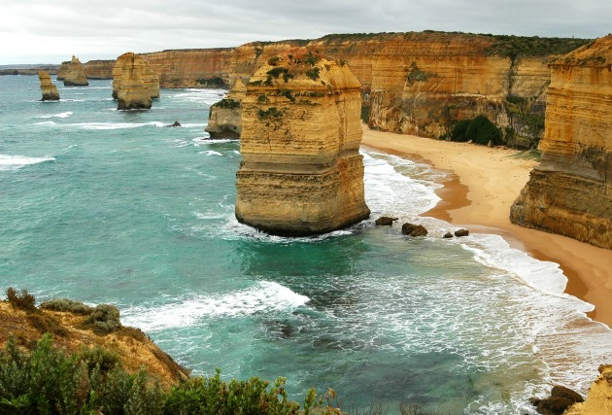
Coastal Landscapes
A section of coastline that has a range of coastal features like a stack, beach or cliff etc.

Slide 19
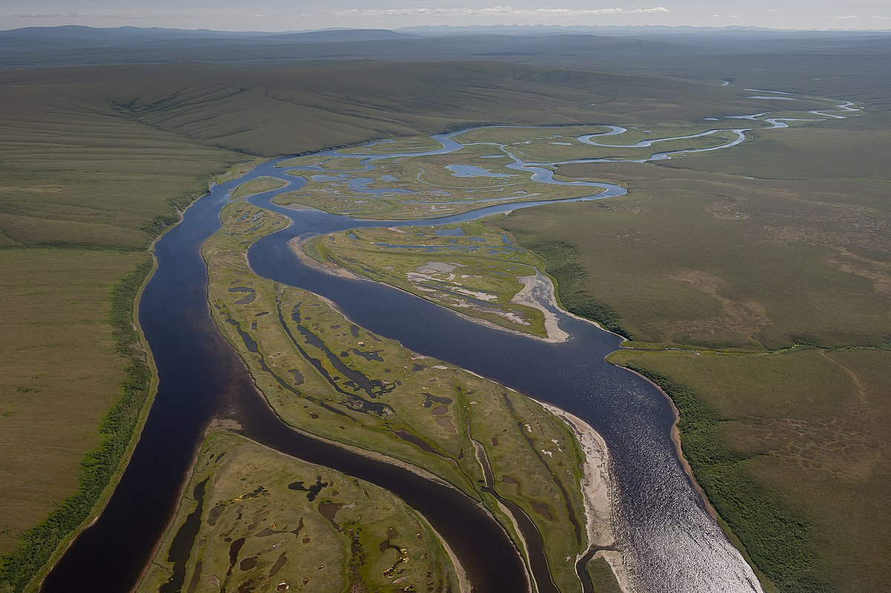
Riverine Landscapes
A network of rivers and surrounding land, including the ecosystems.

Slide 20
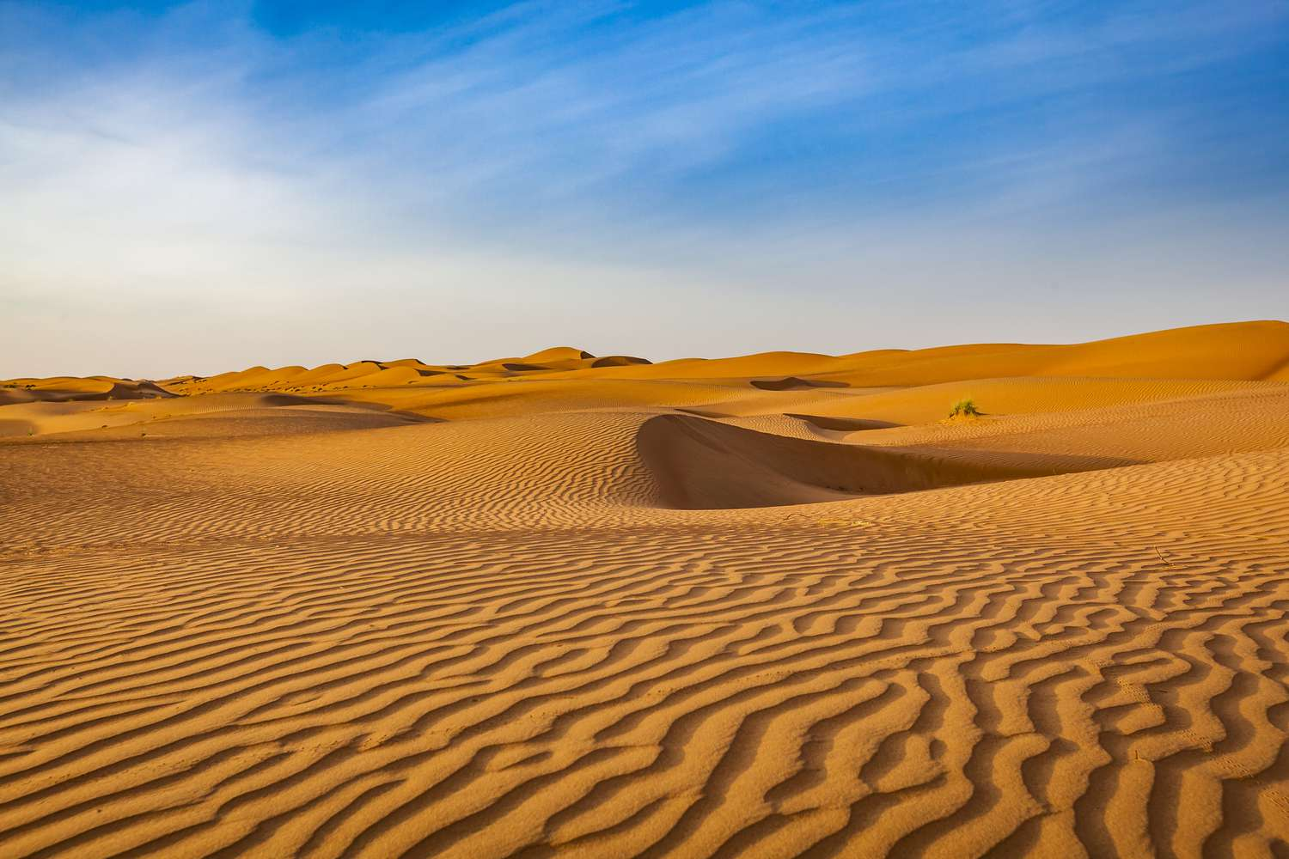
Desert Landscapes
An area of land that receives no more than 25 centimetres (10 inches) of precipitation a year.

Slide 21
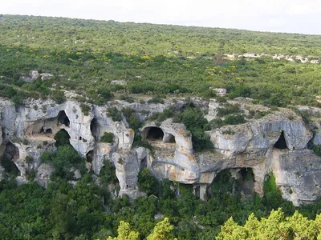
Karst Landscapes
Occur where the dissolving of the bedrock has created sinkholes, sinking streams, caves, springs, and other characteristic features

Slide 22
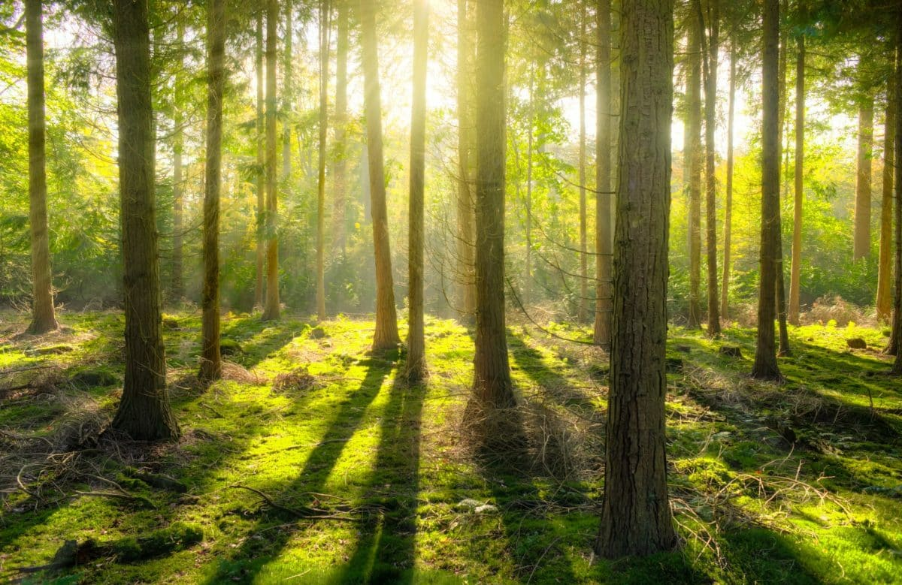
(Rain) Forest Landscapes
A forested area is an area covered in trees growing closely together

Slide 23
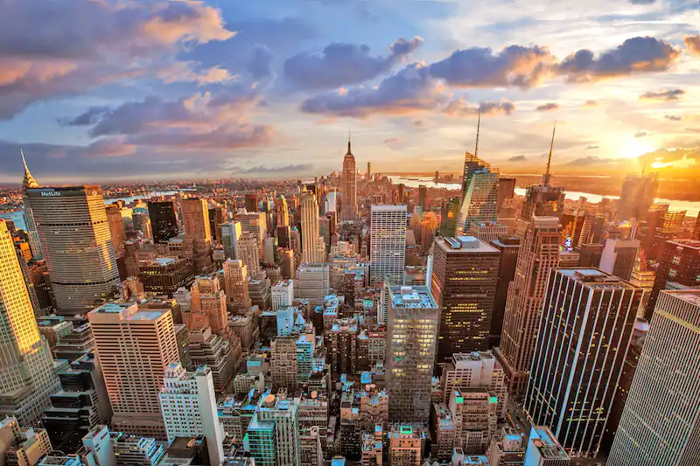
Built Landscapes
A landscape that has been altered by humans. Cities, roads, buildings, bridges, and mass transit are all part of built landscapes.

